Slide 1
MVPA
Multivariate Pattern Analysis
aka multivoxel pattern analsysis
aka SVM (Support Vector Machine), aka classifier

Slide 2
A widely used method in neuroscience
fMRI
EEG
MEG
Single-cell recordings
Etc., etc.
Analysis of multiple dependent variables (brain signals) simultaneously

Slide 3
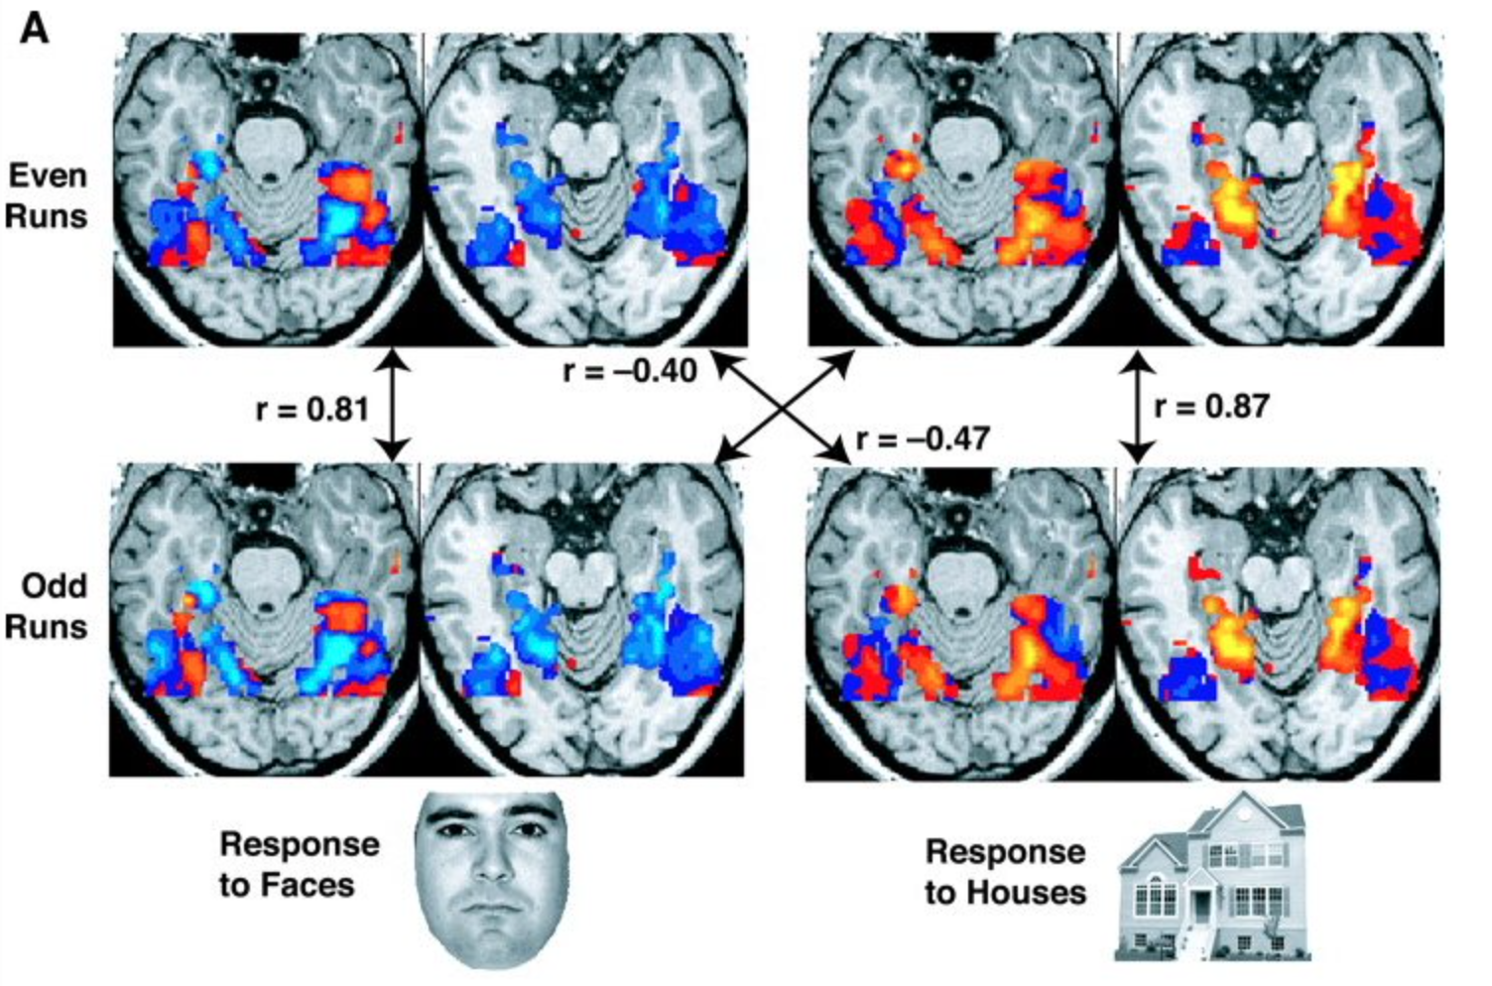
First MVPA paper
Haxby et al., Science 2001

Slide 4
First MVPA paper
Haxby et al., Science 2001

Slide 5
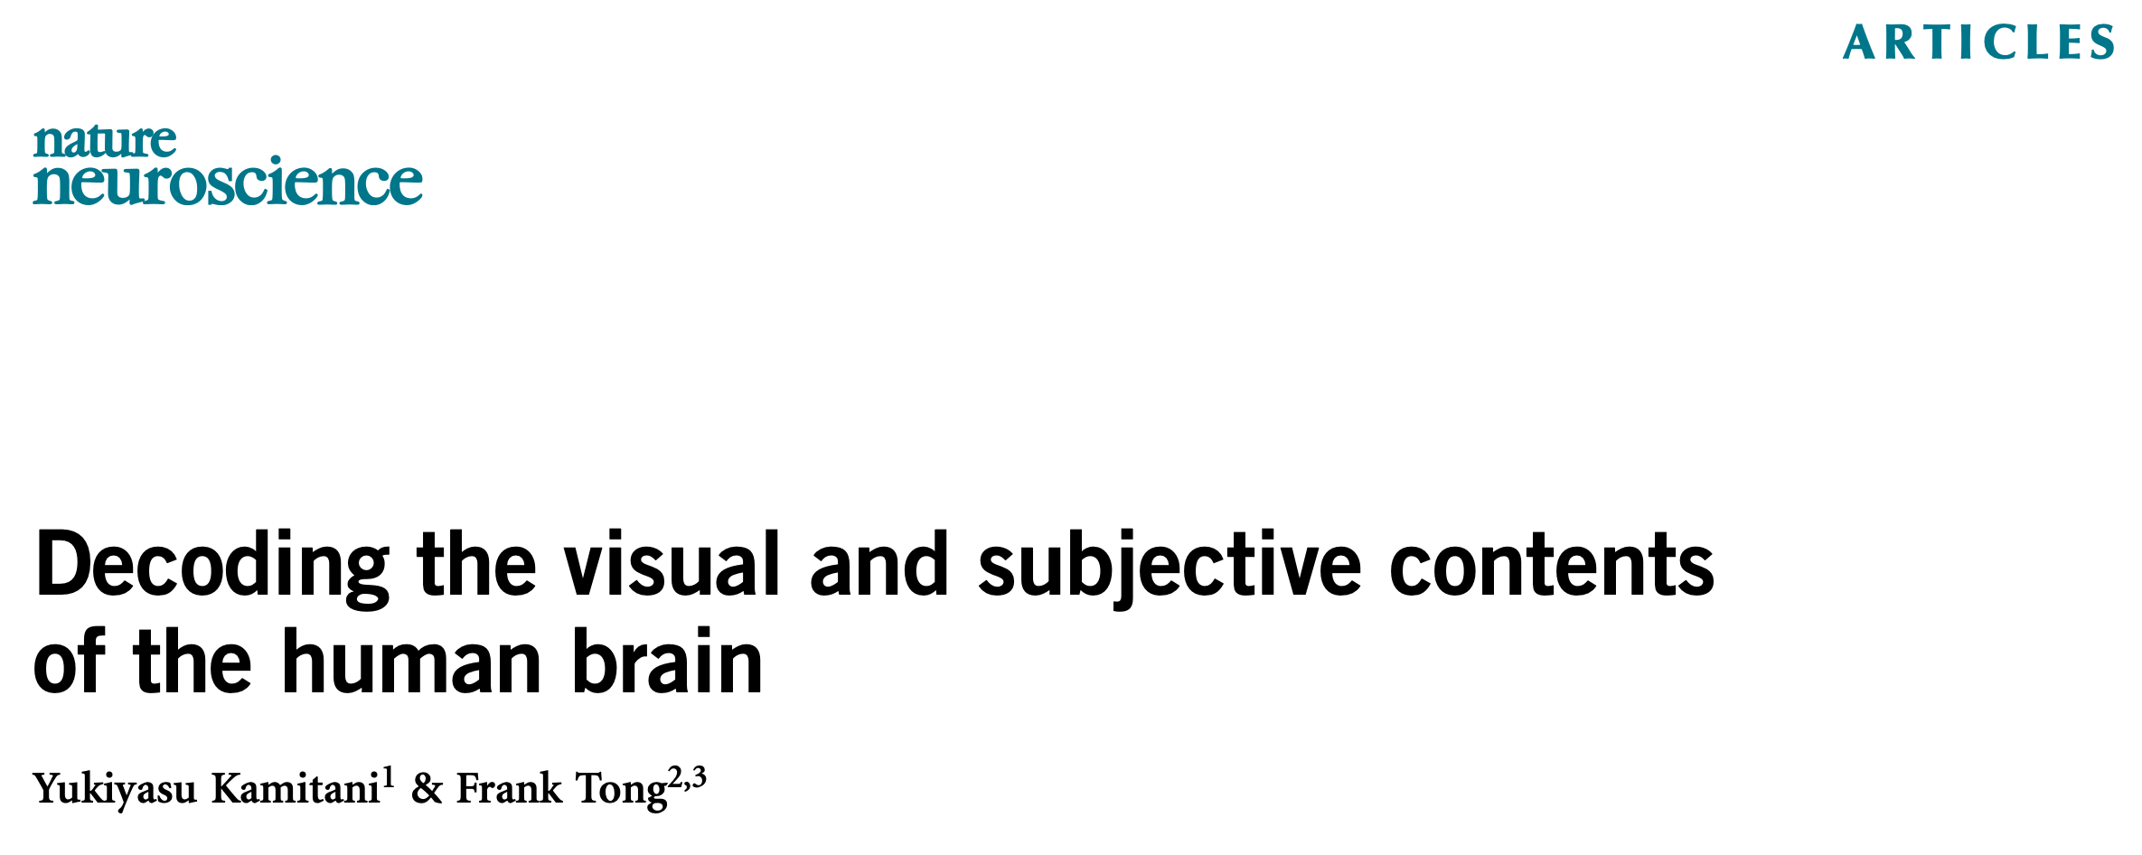

First SVM paper(s): year 2005

Slide 6
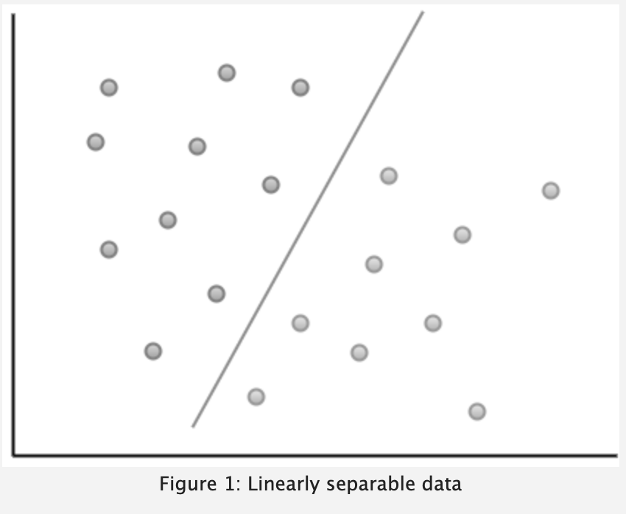
Main principle: 2D
Electrode 2
Voxel 2
Time point 2
Neuron 2
Electrode 1
Voxel 1
Time point 1
Neuron 1
https://eight2late.wordpress.com/2017/02/07/a-gentle-introduction-to-support-vector-machines-using-r/

Slide 7
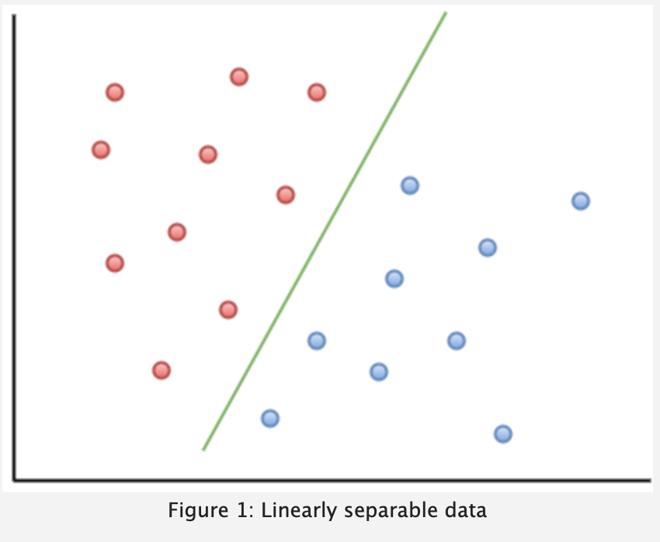
Main principle
Electrode 2
Voxel 2
Time point 2
Neuron 2
Electrode 1
Voxel 1
Time point 1
Neuron 1
https://eight2late.wordpress.com/2017/02/07/a-gentle-introduction-to-support-vector-machines-using-r/

Slide 8
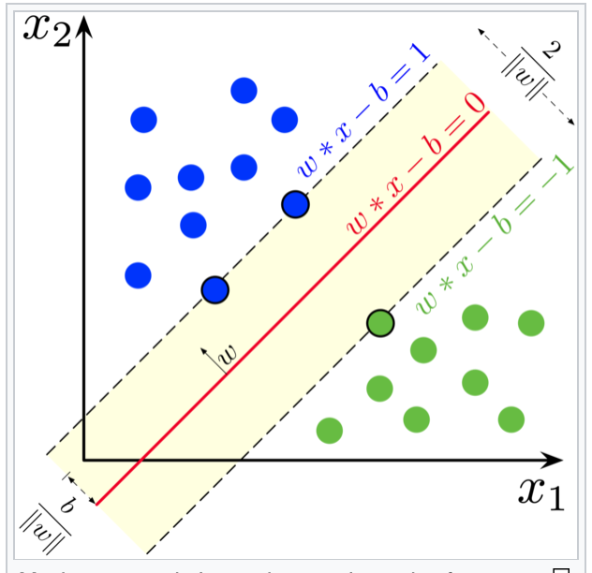
Main principle
Electrode 2
Voxel 2
Time point 2
Neuron 2
Electrode 1
Voxel 1
Time point 1
Neuron 1
https://en.wikipedia.org/wiki/Support-vector_machine

Slide 9
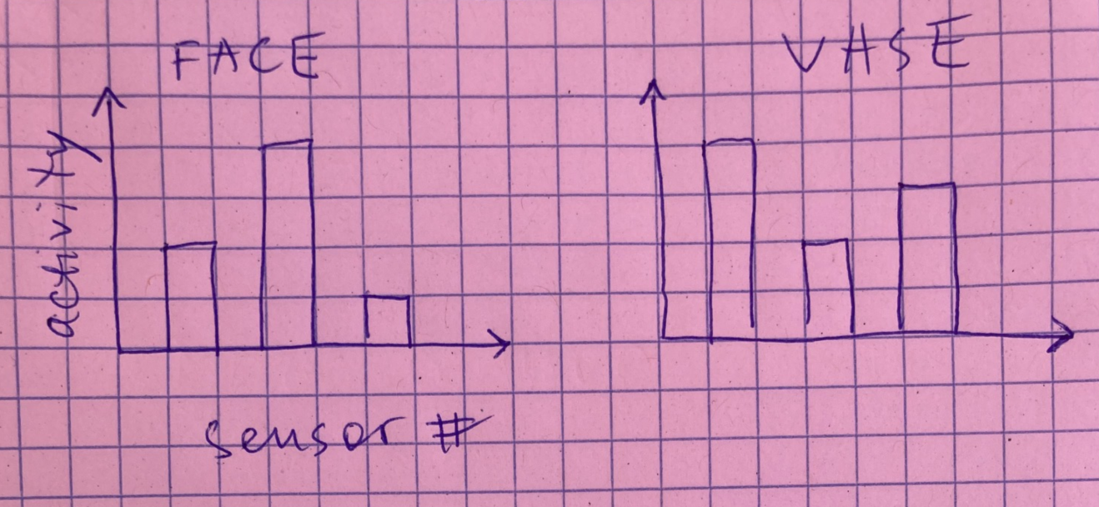
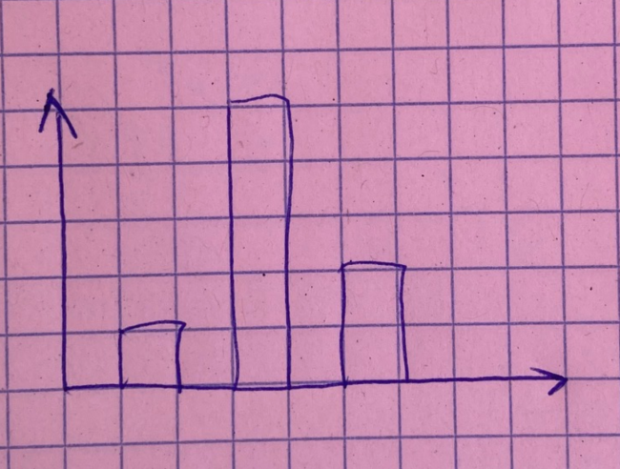
Simplified example
After multiple trials, a classifier learns the differences in neural activity between the face and the vase trials:
Every time a new trial (the one it did not learn from) is presented, a classifier makes a binary decision about the trial type based on what it previously learned:
The classifier categorizes this as a face trial, and the researcher compares it against ground truth (actual subject’s response). If this procedure is repeated many times, you can determine classifier accuracy and compare it with chance level (50%) in our case

